Slide 1


Death, Birth,
BOOks, Balance

Slide 2
Who am I?
Denver Huff
dmh00015@mix.wvu.edu
202-243-8465
Rising 3L at West Virginia University College of Law
Psych background

Slide 3
Why did I join this effort?
Major Life Events
Sense of Community
Communication Channels
Coping and Overcoming Challenges

Slide 4
Semester 1 - Loss
Notes:
It was the weekend before Halloween. I was dressed up to go out and just arrived at a friend’s house. I barely said hi to everyone when I received a phone call from my step mom. My brother had died.
His world ceased to exist while the rest of the world kept spinning. A sense of personal responsibility forces you, even in your worst moments, to understand that you have to communicate what’s going on. I found myself having to draft this professional email to my dean and not remember how it’s even done. I let her know that I would not be able to come to class the following week and why. Once I communicated my needs, I found that there is a deep sense of community in the law school. My Dean texted me to check in on me and the student government collected donations for charity, which was called for in lieu of flowers. Once I returned to class, people who had experienced loss pulled me aside to let me know I was not alone. A sense of community made me feel like I could cope with the situation and overcome the challenge.

Slide 5
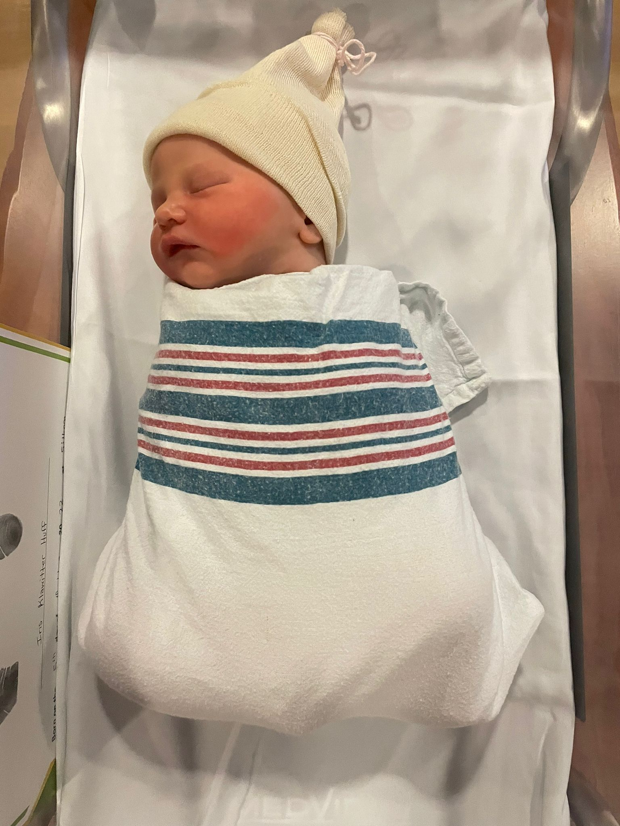
Semester 3 - Birth

Slide 6
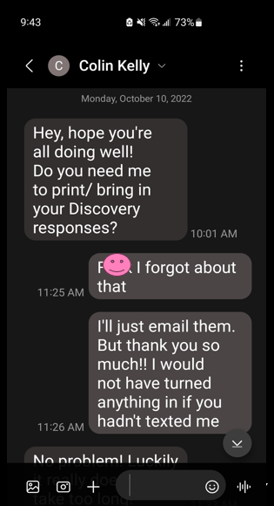
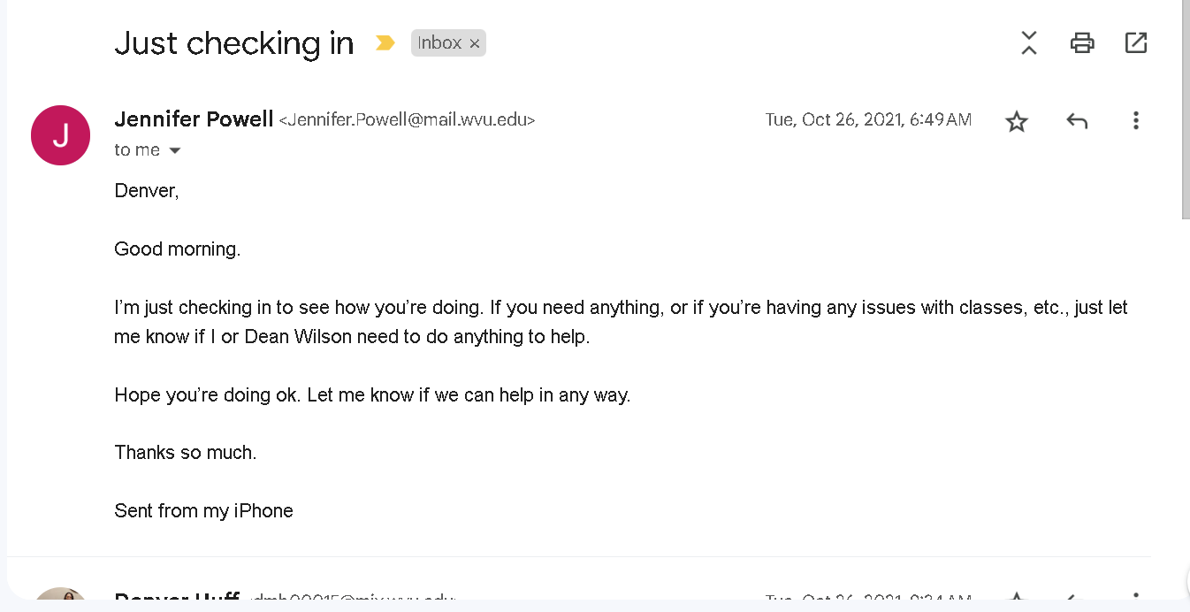
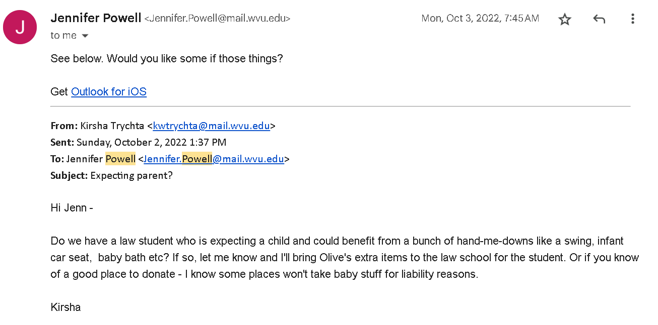

Sense of Community
Notes:
Positive reception and efforts come from everywhere:
My law school inner circle
Other moms in law school
The student body
Professors
Deans
The WVU Office of Accessibility Services

Slide 7
Open Channels for Communication
To get the community involved, the community must know.
Communication openly received.

